Slide 1
Strava & weather: is there a correlation?
DS Group 7
Pieter, Luigi, Julius, Jasper & Ingmar

Slide 2
Overview
Intro to Strava
Project aim
Design plan
Results
Conclusion

Slide 3
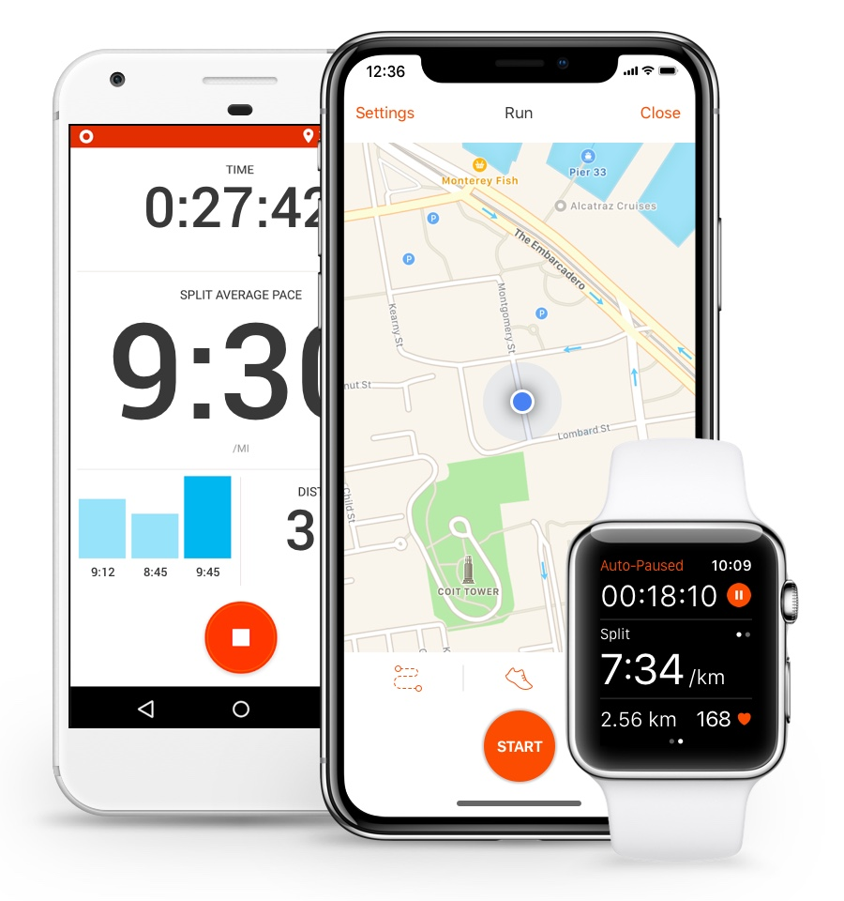
Intro to Strava
Intro to Strava
Project aim
Design plan
Results
Conclusion
Activity tracker
Segments
Leaderboards
42 million users worldwide

Slide 4
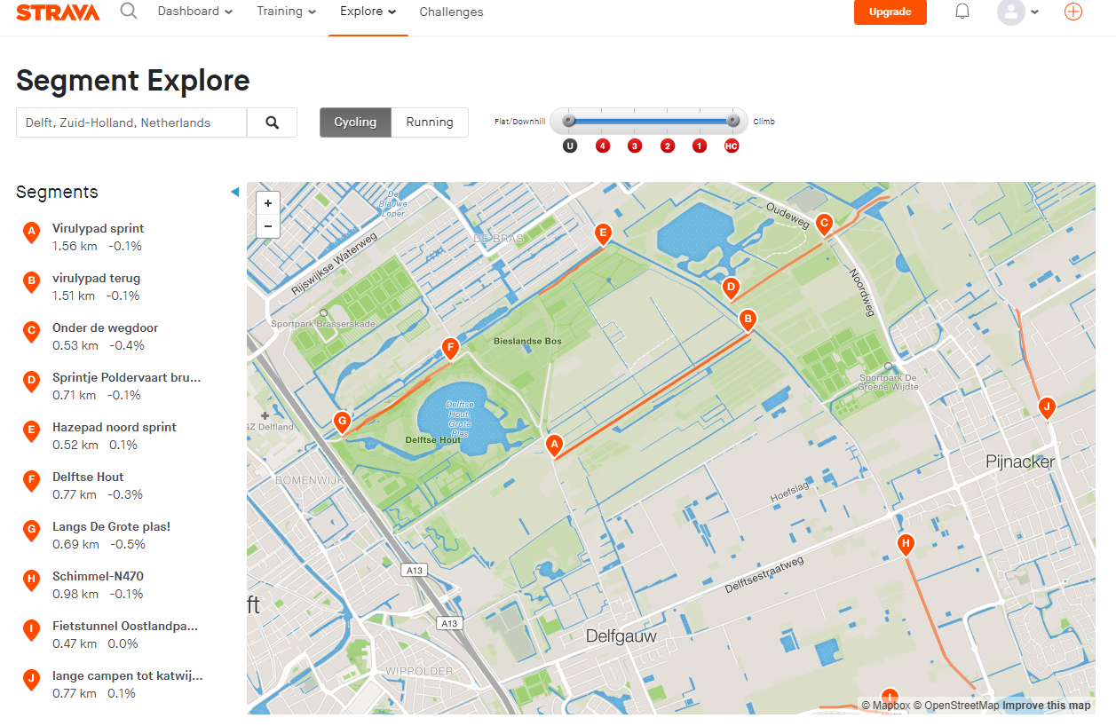
Intro to Strava
Project aim
Design plan
Results
Conclusion

Slide 5
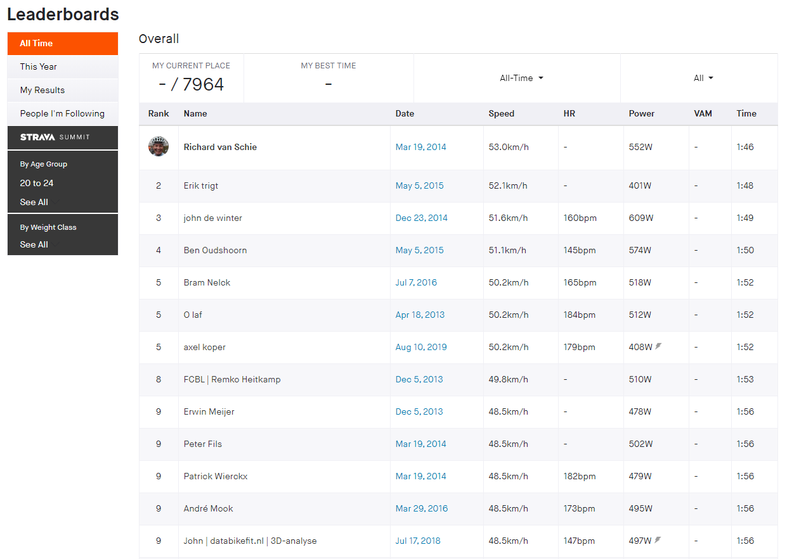
Intro to Strava
Project aim
Design plan
Results
Conclusion

Slide 6

Project Aim
Intro to Strava
Project aim
Design plan
Results
Conclusion
Find correlation between weather and places where Strava users cycle

Slide 7
Constraints
Intro to Strava
Project aim
Design plan
Results
Conclusion
KNMI is limited to the Netherlands
Not all cyclists use Strava
Strava’s popularity over time
Defining a good weather scoring is difficult
Amount of requests

Slide 8
Design plan
Intro to Strava
Project aim
Design plan
Results
Conclusion
Controller
Strava Module
Weather Module
Obtain data
Filter data
Weather score
Obtain data
Analysis
Heat maps
Base line

Slide 9

Strava Module
Intro to Strava
Project aim
Design plan
Results
Conclusion
Notes:
- Verwijs naar het plan om enorm veel API’s te maken zodat we de data snel genoeg op zouden kunnen halen. Kan niet → scale project down, naar 5x5 km grids. 35 uur run time dit leverde 19 miljoen data punten op en als we dit opsloegen in csv kreeg je 1.5 G → dus naar parquet omgezet. Echter zat nog veel onzin zoals een datapunt met datum als 2073 dus dat moest eruit, dan krijg je uiteindelijk dit.

Slide 10

Strava Module
Intro to Strava
Project aim
Design plan
Results
Conclusion
35 hours
19 million datapoints → 1.5 GB csv → 175 MB parquet
1-1-2073?

Slide 11
Strava Module
Intro to Strava
Project aim
Design plan
Results
Conclusion
Hier moet filtered data nadat er een groupby over is gegaan!!!
Notes:
Showing final data

Slide 12
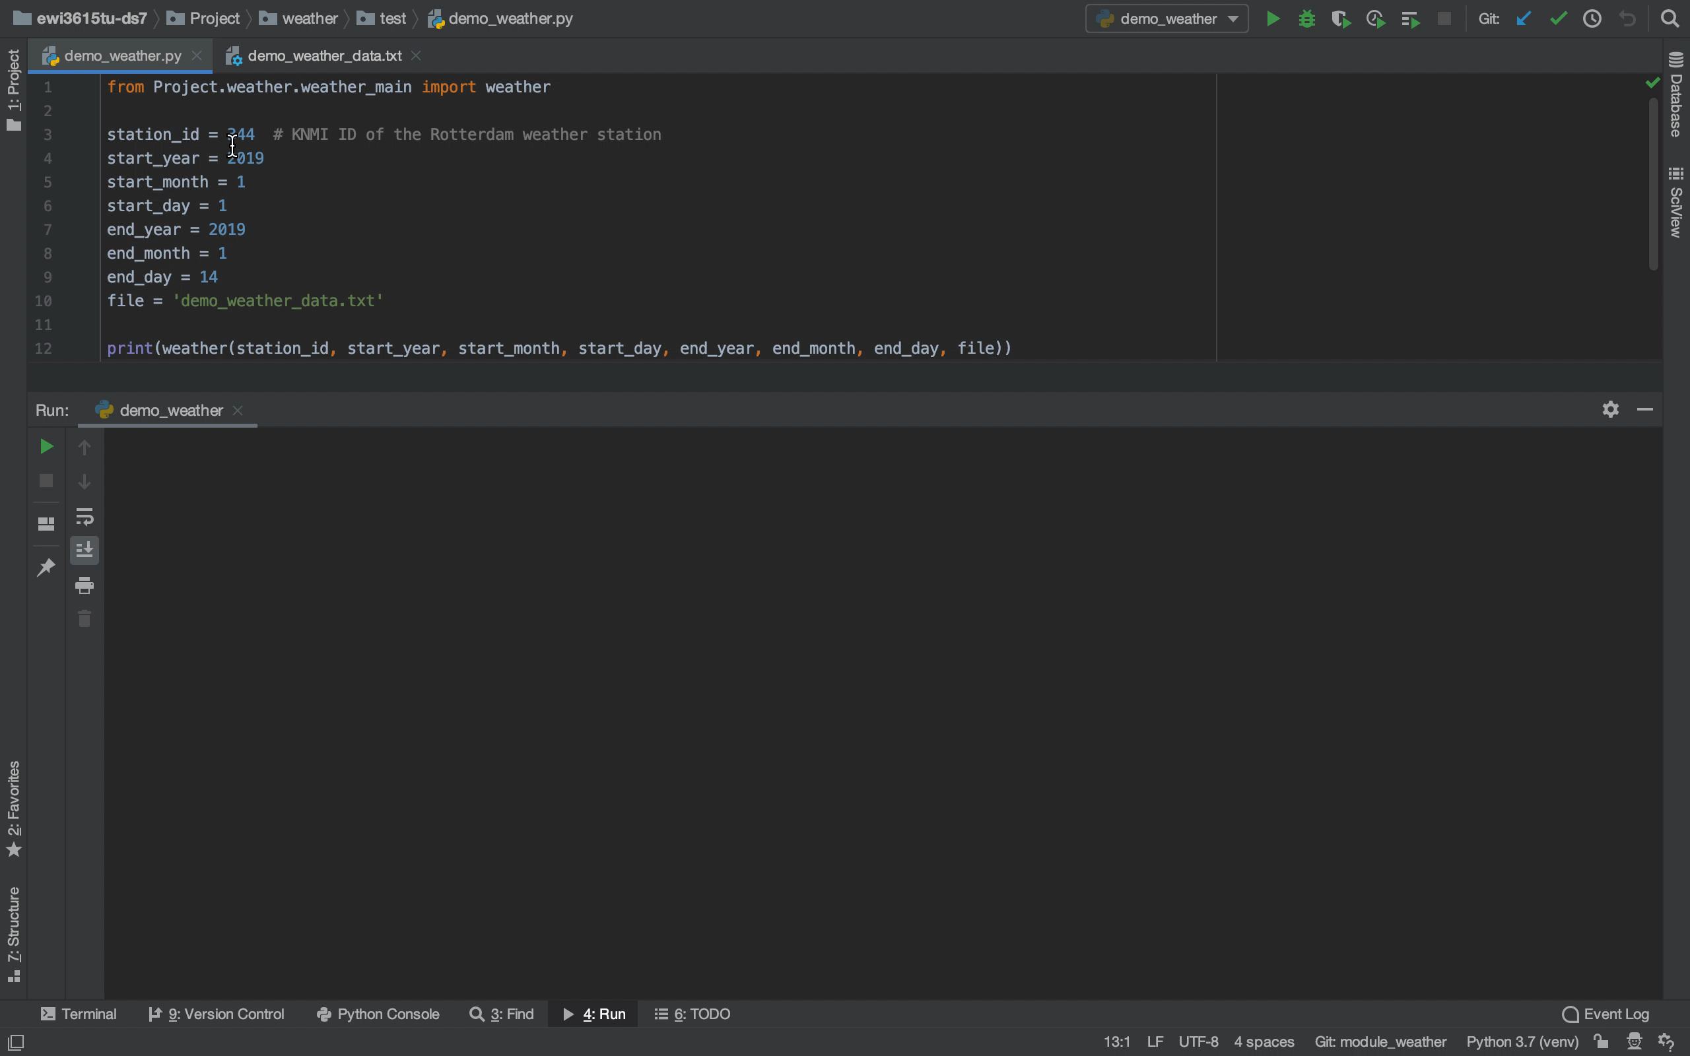
Weather Module
Intro to Strava
Project aim
Design plan
Results
Conclusion

Slide 13

Analysis Module
Intro to Strava
Project aim
Design plan
Results
Conclusion
Define baseline
Link strava data to weather data

Slide 14
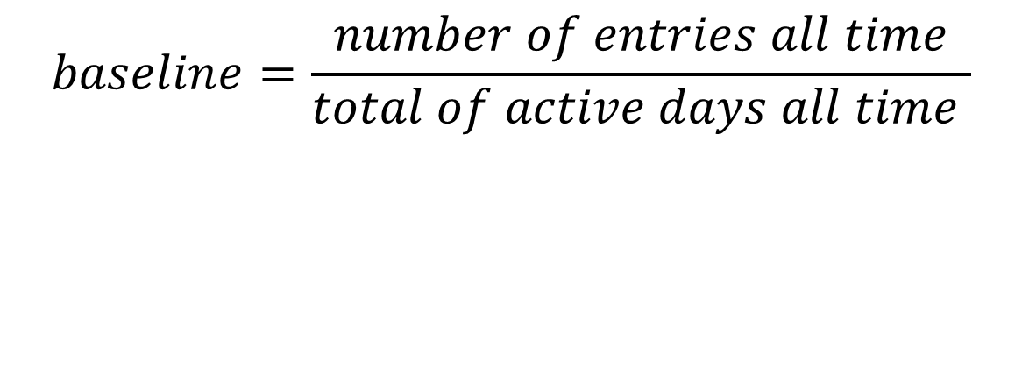
Analysis Module
Intro to Strava
Project aim
Design plan
Results
Conclusion
$$baseline=\frac{number of entries all time}{total of active days all time }$$
Notes:
Mention the baseline of segments where the segment was used only one day by a race! So you got 180 for example.

Slide 15
Analysis Module
Intro to Strava
Project aim
Design plan
Results
Conclusion
Set weatherstation per segment
Nog aanvullen met afbeelding van samenvoegen dataframes

Slide 16
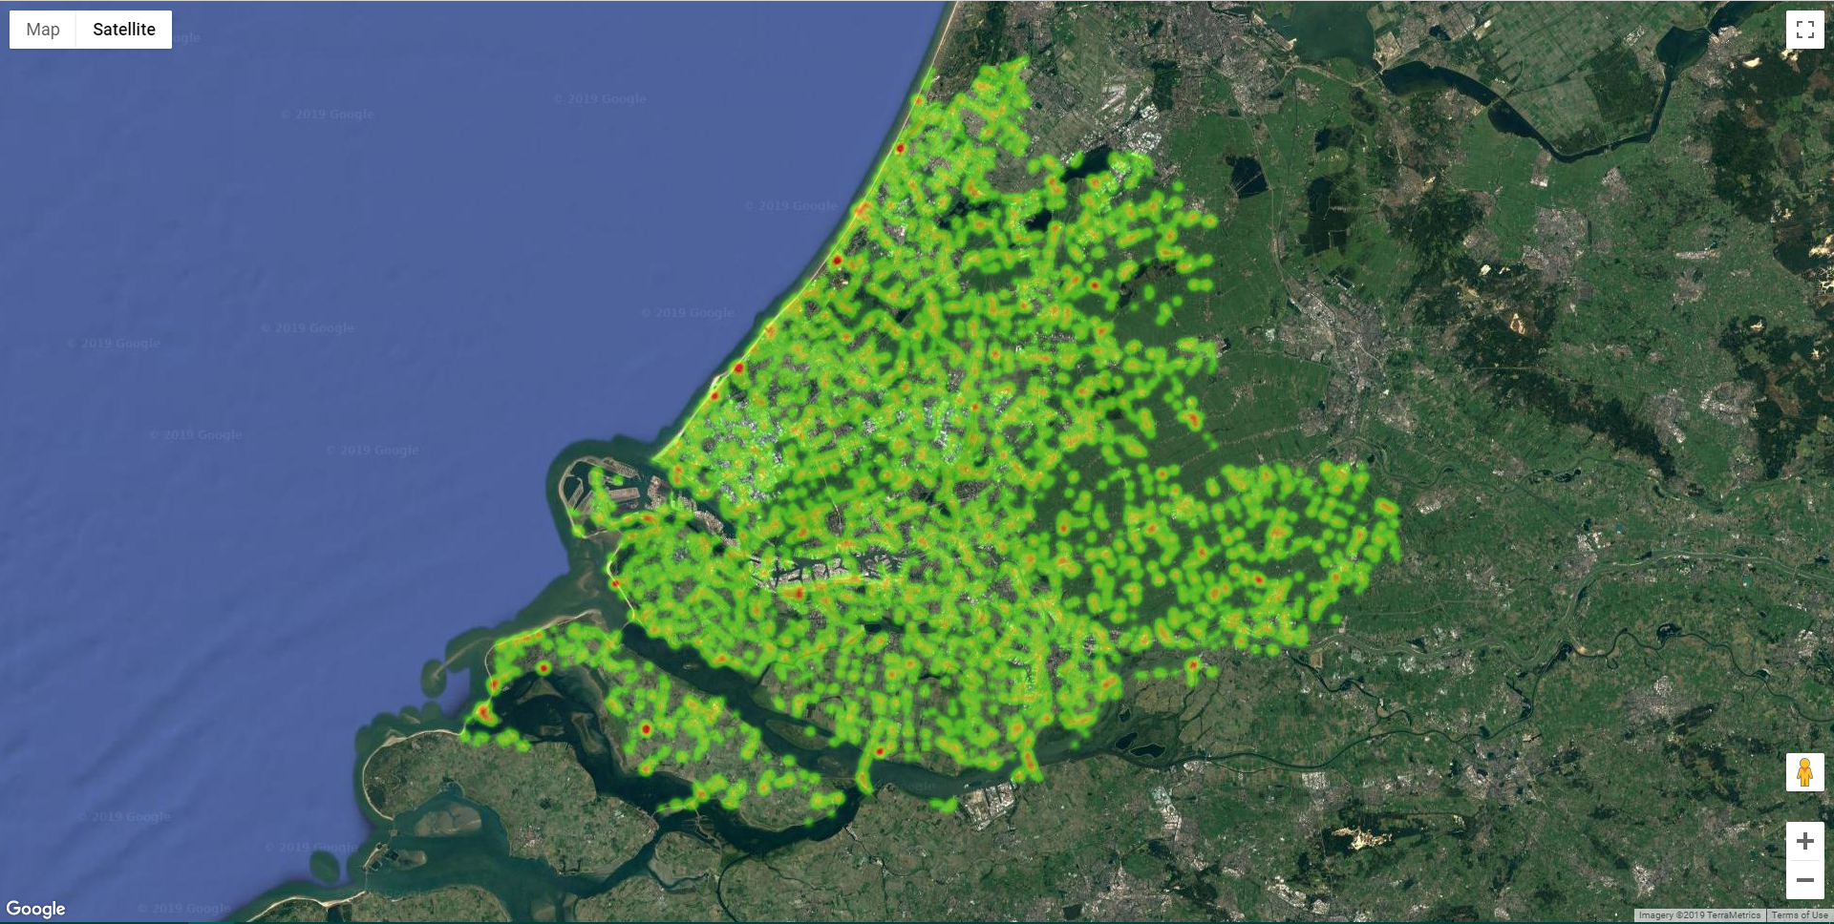
Visualization Module
Intro to Strava
Project aim
Design plan
Results
Conclusion

Slide 17
Implementation update
Weather module:
Works, weather scoring needs some refinement
Strava module:
Too many requests
Analysis module:
Visualization is finished

Slide 18
Further steps
Build analysis module
Scrape!

